Slide 1
DIET PLANNER
Presented by :
Aditi Bhiwaniwala
Neha Gadgil
Shubham Patil

Slide 2
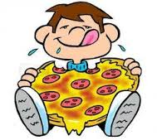

Slide 3
THE IDEA
A healthy mind resides in a healthy body !
It is a dream of every individual to have a healthy and fit body !
There are many dieticians, planners, trainers out there who would train you to achieve your dream.. But at a cost !
How would it be to have a planner that plans meticulously , only for you, tracks you , maintains the record of your daily intake of calories/ fats and recommends changes in your diet on per day basis ? And that too totally free?
Interested? Hang on then !

Slide 4
THE IDEA
The product that we have designed, using the APIs of IBM WATSON does the specified job.
It can hold data for multiple users.
And yet it is customisable for every person !

Slide 5
THE IDEA
Initially, at the time of sign up, it asks the following information from the user:
Name
Password
Age
Height
Weight
Activity (ranging from sedentary to very active)
Gender.

Slide 6
THE IDEA
It then calculates , using the last four parameters, the daily total energy expenditure or the average energy consumption per day is calculated and saved for that person.
It will also ask the user his/her aim.. That is , would the user like to gain weight or lose weight or remain maintained!
The total energy expenditure will then be modified accordingly.
An initial prescribed diet plan will be generated and presented to the user. The user is expected to stick by it.
The daily calorie intake is analysed.

Slide 7
THE IDEA
The application supports a huge dataset of varied foodstuffs and their respective calorie values.
The application would then ask the user everyday to tell it about whatever was eaten by the user that day.
Still finding it interesting ? Great ! Hang on !

Slide 8
THE IDEA
And then the application analyses the total calorie intake for that day of the user and checks if it is in accordance with the calculated level.
In any case if the total consumed calories are beyond the calculated level, the application gives out a warning that you have overstepped your daily limit and also gives suggestions that you could cut down on these particular foodstuffs.

Slide 9

THE IDEA
If thIf the calorie intake is below the specified value then the application gives out a message to reward oneself with some lip-smacking-high-on-calorie foodstuffs.
e calorie intake for the day is well in range then it’ll give out a message ‘great going ! Keep it up’.

Slide 10
THE IDEA
When this analysis is done on a daily basis, the user understands what sort of foodstuffs he/she must avoid or what eating patterns must be followed to give out perfect calorie balance.
This in turn helps the user to follow proper diet and have a healthy lifestyle !

Slide 11


Slide 12
IBM WATSON APIs USED
Watson speech-to-text.
Watson text-to-speech
Watson visual-recognition

Slide 13
HOW ARE THEY USED?
“What did you eat today ?”
This can be answered in two ways!
You either talk to the application ! (Watson speech to text used)
Or you can simply upload the images of your food in one click! (Watson visual recognition used)

Slide 14
IBM WATSON APIs USED
Watson speech-to-text.
A .wav audio file is generated when user answers the question. This file is then taken up by the API and converted to text. This text is then parsed for the names of foodstuffs to capture and calculate the calorie value.
This value is then used to check against the TEE value.

Slide 15
IBM WATSON APIs USED
Watson visual- recognition.
People these days are very must picture crazy. They click pictures of every small thing they eat, do or experience.
Banking on that very concept, we have introduced this option of uploading pictures of all that you have eaten in the day.
The pictures will then be sent to the visual recognition API and the foodstuffs in the pictures will be recognised and their calorie values will be added up to calculate the intake !
The API can be trained to recognise the regional foodstuffs as well.

Slide 16
IBM WATSON APIs USED
Watson text-to-speech
This API is majorly used to convert the result string into speech. For example : You need to cut down on ice-cream ! This can be narrated for better impact.
The string of analysed result from the calorie calculation is passed into text-to-speech API and played using pyaudio.

Slide 17
TECHNOLOGIES USED
IBM Watson developer cloud.
Django
Pyaudio library
Python wave module.
HTML, CSS

Slide 18
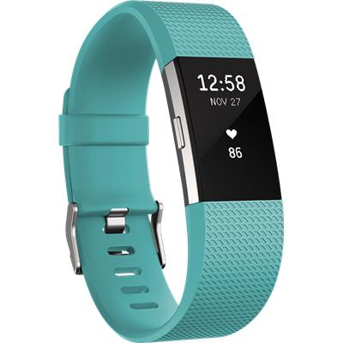
WHAT ELSE CAN BE DONE?
Watson Iot API
Just as the Calorie intake is taken into account, we
can also take the calorie burnout of each person
into consideration.
This can be done using devices like FitBit etc. The data generated out of them can be captured using the IoT API and the total burnout of calories can be deducted from the total consumption of the day to get more accurate results.

Slide 19
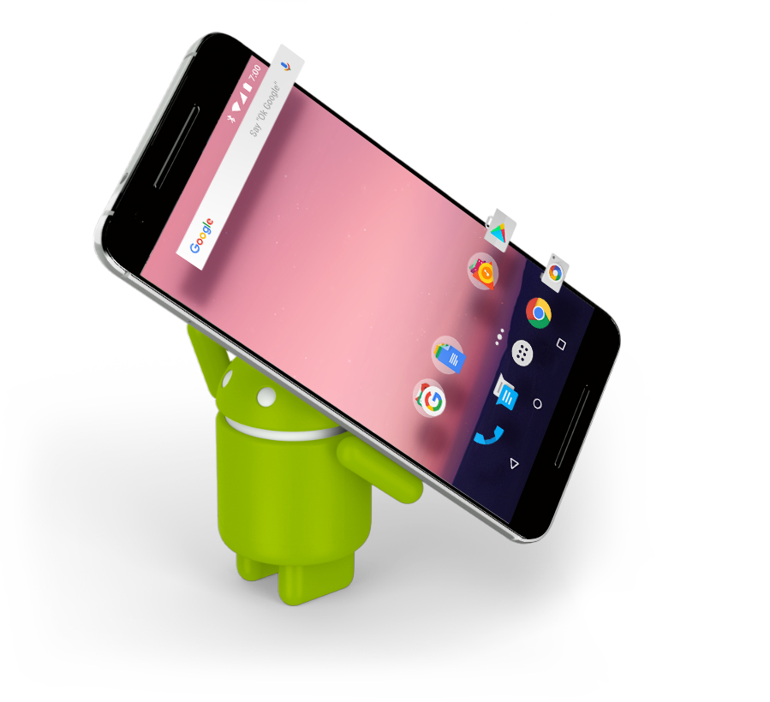
FUTURE SCOPE
Android app development of this idea that will take the diet planner closer to the user..

Slide 20
The diet planning can be made more specific (for example lose or gain 10 kgs in 20 days or so) and the plans and analytics can be made accordingly rigorous. This will need a wide research the field of food and nutrition.
When complete, it would definitely be something that every health conscious person will love to have !

Slide 21
CHALLENGES FACED
The major issue was finding reference material for understanding the bluemix platform(and hence it didn’t get integrated!)
Next was dealing with the speech to text API of IBM Watson. It gives hard time recognizing the Indian accent.(Terrorist became dentist :p)

Slide 22
CHALLENGES FACED
Finding proper and authentic information about food and nutrition and calorie values of food stuff.

Slide 23
CHALLENGES FACED
The major issue was finding reference material for understanding the bluemix platform(and hence it didn’t get integrated!)
Next was dealing with the speech to text API of IBM Watson. It gives hard time recognizing the Indian accent.(Terrorist became dentist :p)

Slide 24
THANK YOU!!!

